Slide 1
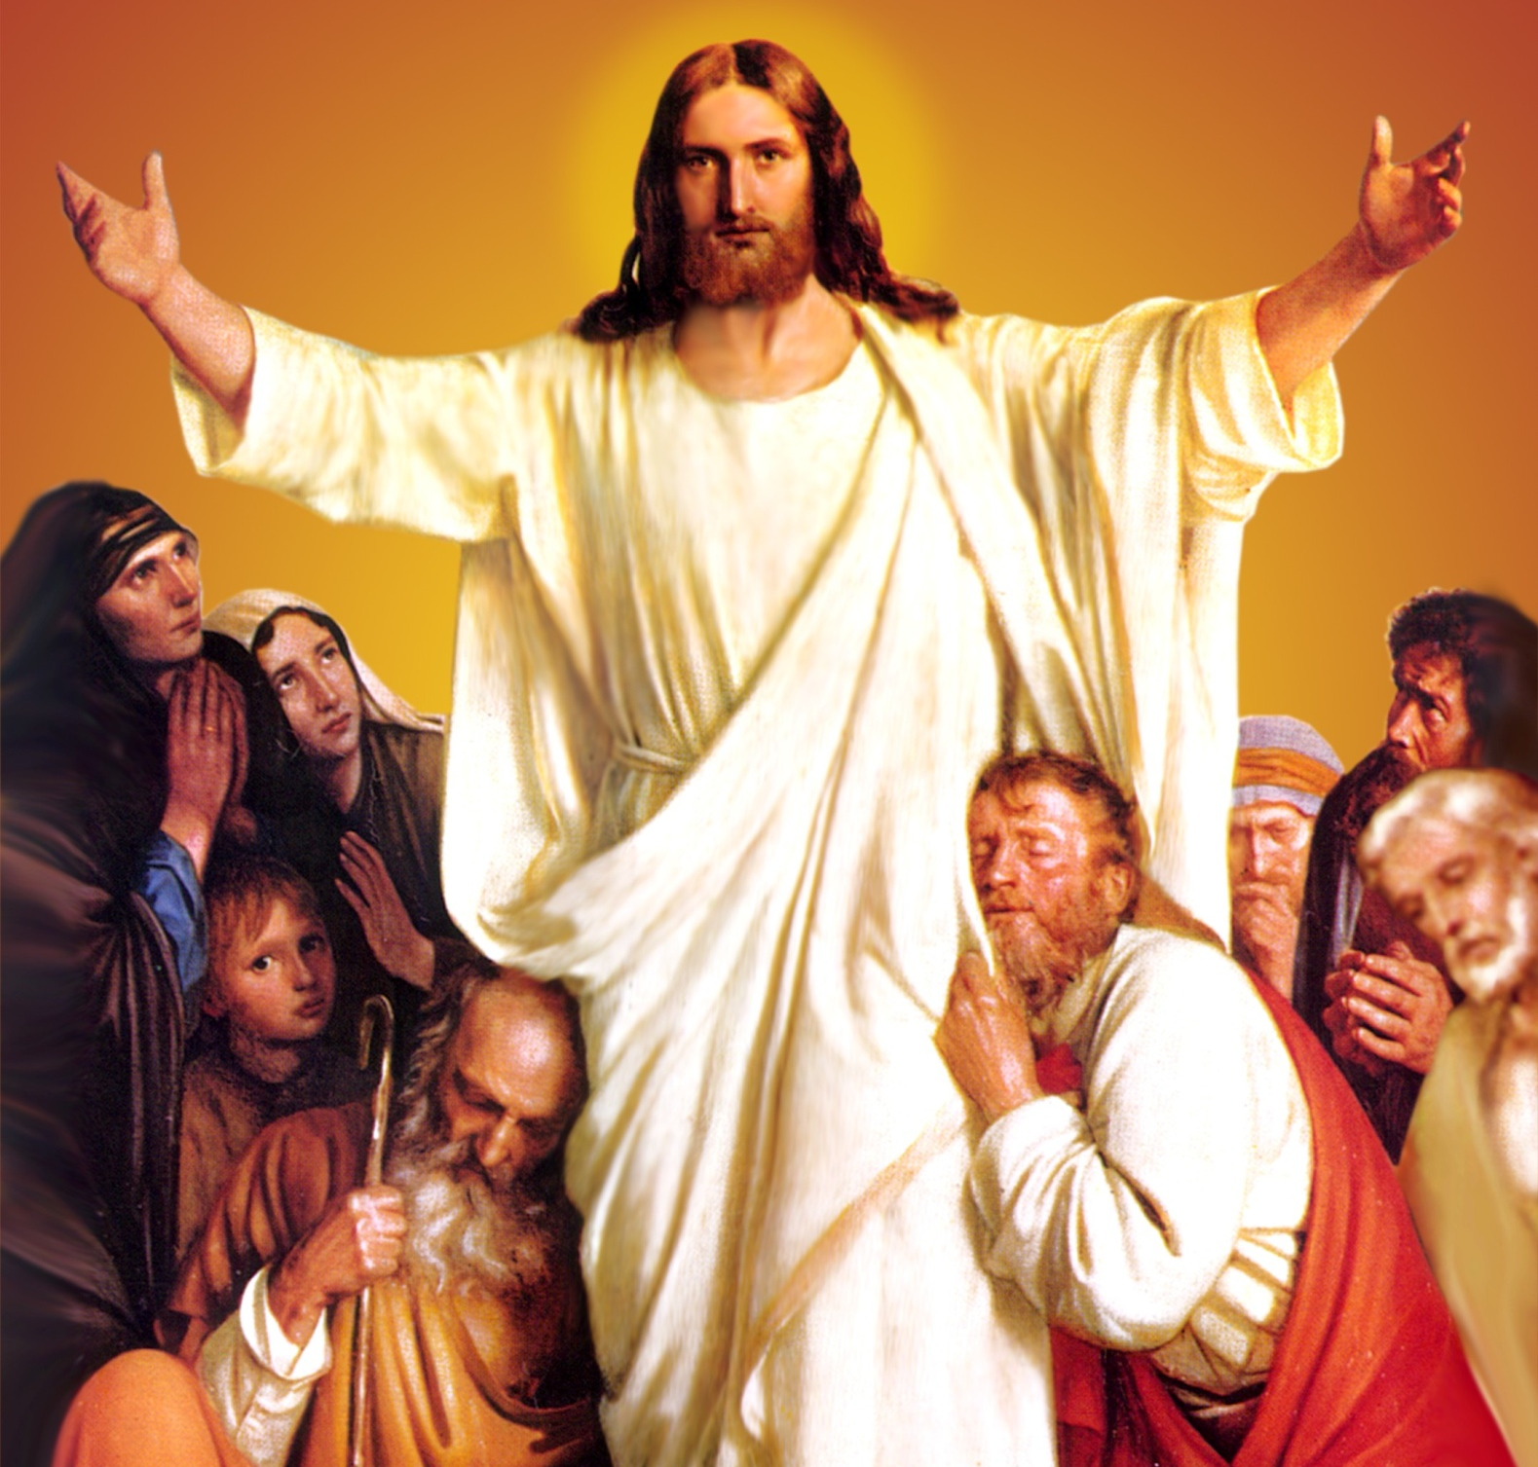
CATECHETICAL TEXTBOOK SERIES OF THE SYRO - MALABAR CHURCH
ON THE PATH OF SALVATION - 6
PEOPLE WHO
EXPERIENCED JESUS
6

Slide 2
LESSON 12
MY LORD AND MY GOD

Slide 3
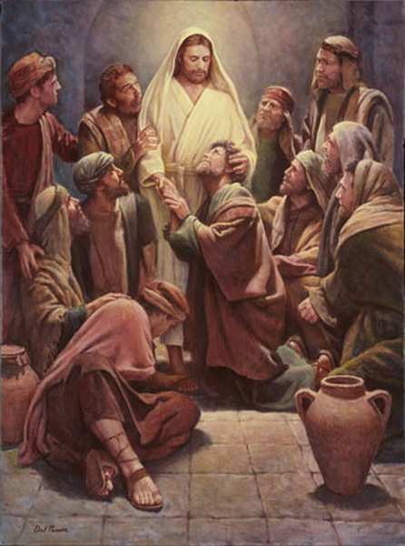
Even though Jesus revealed himself to his disciples in several ways they could not comprehend his passion and death. With the death of Jesus on Calvary they became disheartened and sorrowful. All hopes shattered, at a loss as to what to do next, and afraid of the Jews, the disciples were gathered in a locked room. The very night after the resurrection, Jesus came to the disciples. Standing in their midst he said, “Peace be with you”. Saying this he showed them his hands and his side. The disciples rejoiced at the sight of Jesus. Jesus spoke to them again, saying, “Peace be with you” (Jn. 20 19- 22). Thus Jesus cleared all doubts and sorrows from the minds of his disciples and made them happy. They experienced the love and the glory of the risen Lord.

Slide 4
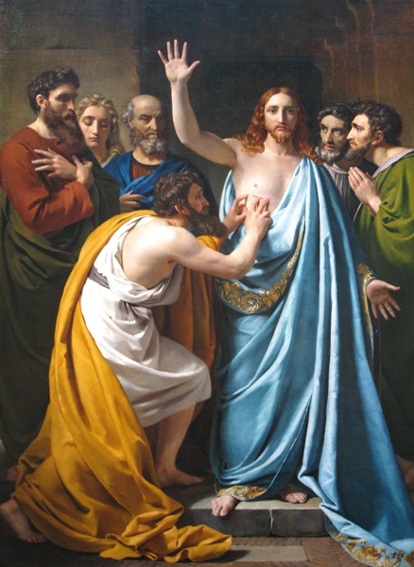
PROFESSION OF FAITH OF ST. THOMAS
When Jesus appeared to the disciples, Apostle Thomas was not there. When he joined them the other disciples said to him, “We saw the Lord”. But he said, “Unless I see the marks of the nails in his hands, and put my finger in the mark of the nails and my hands in his side, I will not believe” (Jn. 20:25). This reaction was the result of a mixed feeling; the pain of missing the resurrection experience that the others had and the strong wish that he also must get that experience. Thomas was the disciple who was prepared to face even death to be with the Lord. When the other disciples tried to stop Jesus from visiting the house of Lazarus, it was Thomas who said with courage, “Let us also go and die with him” (Jn. 11: 16).

Slide 5
Eight days later when the disciples were indoors like this, Thomas was also with them. And the doors were closed. Jesus came, stood in their midst and said, “Peace to you!” Then he said to Thomas, “Put your finger here and see my hands. Reach out your hand and put it in my side. Do not doubt, but believe” (Jn. 20: 26- 28). Jesus was inviting Thomas to obtain the resurrection experience and to rise to the fullness of discipleship.

Slide 6
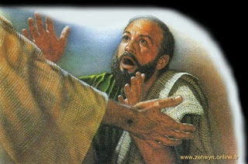
MY LORD, MY GOD
Immediately on hearing these words of Jesus, Thomas said, “My Lord, My God.” Jesus said to him, “Have you believed because you have seen me? Blessed are those who have not seen and yet come to believe” (Jn. 20: 28- 29). Thomas was confessing Jesus as Lord and God. That was the most sublime declaration of faith.
Faith is the response to divine revelation. Believing in your heart that Jesus is Lord and confessing it with your lips is the demonstration of faith (Rom. 10: 9).

Slide 7
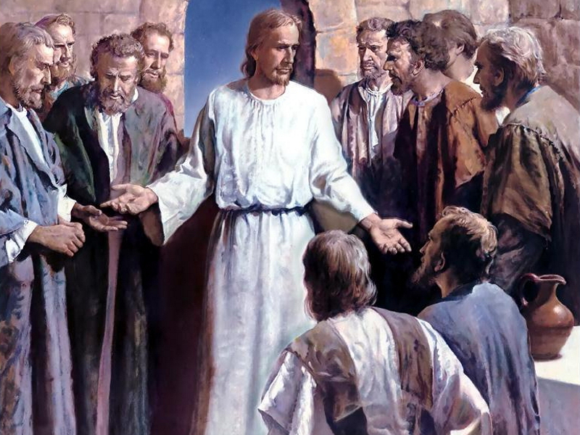
CHRIST EXPERIENCE
A disciple is one who lives with the master, understands him and experiences his love. Jesus also took his disciples around with him and taught them. He made them participate in the miracles and signs. He explained to hem his concepts of the Kingdom of God. Thus he gave an opportunity to his disciples to realize who he was.
Only those who had been with Jesus and knew him closely can proclaim him. St,. John, the apostle points out this as the authority for their preaching. “We declare to you what we have heard, what we have seen with our eyes, what we have looked at and what we have touched with our hands, concerning the word of life” (1 Jn. 1: 1). This same Christ experience was the criterion that Peter suggested for electing a new disciple to fill the vacancy left by Judas Iscariot. Peter said, “He should be one of the men who have accompanied us during all the time that the Lord Jesus was with us, beginning from the baptism of John until the day when he was taken up from us” (Acts 1: 21- 22).

Slide 8
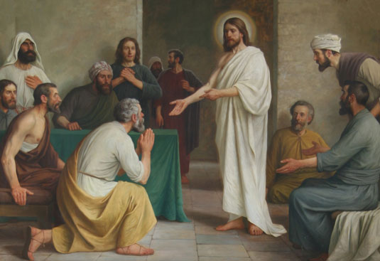
WISHING PEACE
Whenever the risen Jesus made an appearance, his greeting was “Peace be with you”. During the holy Mass, the celebrant offers the same greeting to the congregation. When the celebrant addresses the congregation with the greeting 'peace be with you', the congregation responds with the words, 'with you and your spirit also'. This greeting implies the wish “May Jesus, who is peace, be with us”.
May the profession of faith of our father, St. Thomas, the apostle, be ours as well. Let us proclaim Jesus as our Lord and our God. Let us live with Jesus, for Jesus and in Jesus.

Slide 9
Let us pray
Lord Jesus, give India missionaries who are ready even to die with you following the model of the Apostle St. Thomas who dared to die for you.

Slide 10
Read the word of god:
John 20:19-29

Slide 11
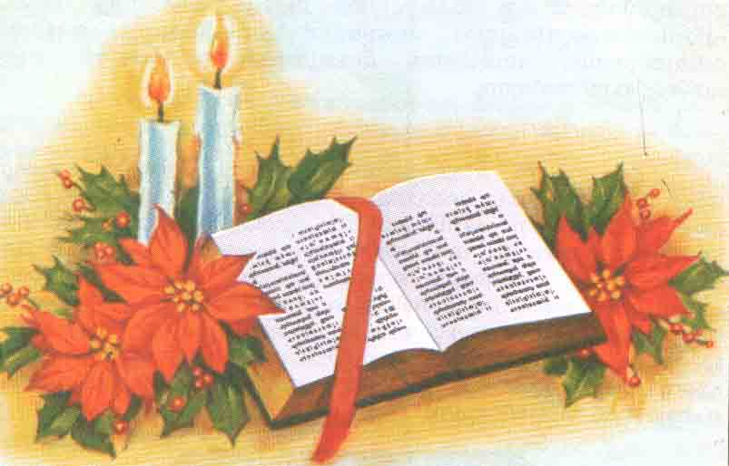
WORD OF GOD FOR GUIDANCE
"Blessed are those who have not seen and yet have
come to believe." (Jn.20:29).

Slide 12
LET US DO:
Write a story about St. Thomas that is told in our tradition

Slide 13
MY DECISION
I will repeatedly recite the acclamation:
"My Lord, My God."

Slide 14
LET US Find out the answer
1. What was the reaction of St. Thomas when he came to know that the other disciples had seen the risen Lord?
2. How did Jesus fulfill the wish of St. Thomas?
3. What did St. Thomas do When he saw the risen Jesus?
4. What was the greeting of the risen Lord whenever He met his disciples?
5. What was the criterion given by St Peter while choosing the disciple instead of Judas?

Slide 15
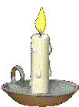
Thank you

